Slide 1
Spring Data JPA
@thecodealchemist

Slide 2
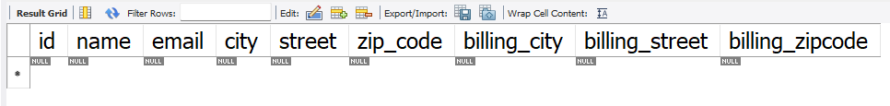
Agenda

Slide 3
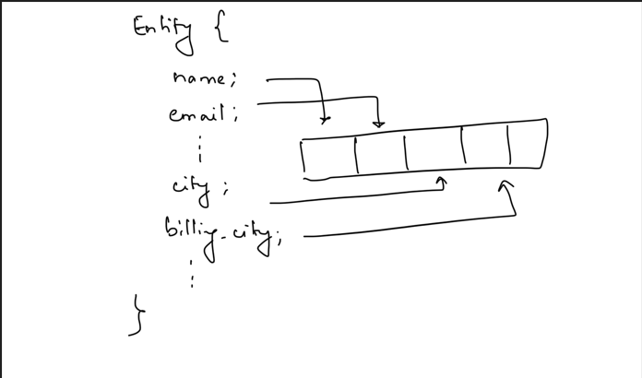
Solution 1

Slide 4
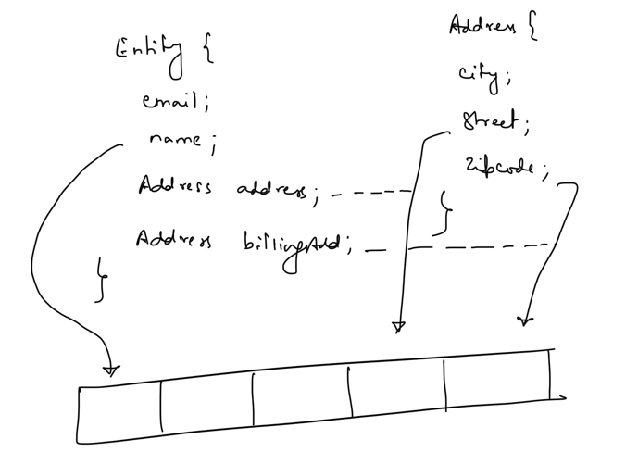
Solution 2

